Slide 1
Hands On Lab!
60 minutes

Slide 2
Create an App Service
Create a new folder called prj1_infra_app
Based on the same model of the previous lab:
Create a variable.tf
Create a locals.tf
Create a provider.tf
Create an rg.tf for a new resource group
The domain will be the “prj1” and add a new variable for the application name and call it whatever you want but limit the characters to 3.
Use remote state and store it inside the Storage Account containers “states” created in the previous lab in this path: prj1/<application name>/terraform.state

Slide 3
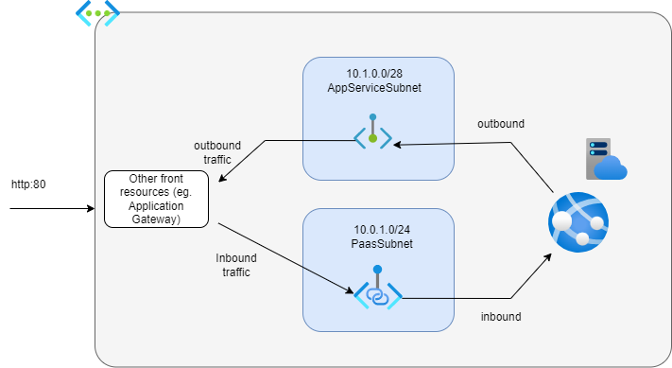
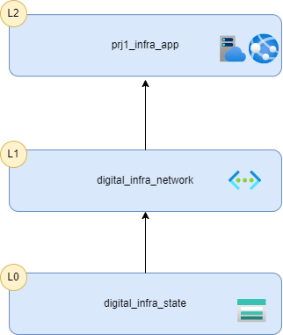
Create an App Service
The goal of this lab is to consume the state network state and activate the VNet integration and private endpoint for the App Service.

Slide 4
Create an App Service
Create an app.tf and define:
An App Service Plan with Basic SKU
An App Service for Linux
Create a data.tf file and use the terraform_remote_state resource to connect to the network state with the correct credential methodology:
https://developer.hashicorp.com/terraform/language/settings/backends/azurerm
In your locals.tf get the subnet ids for the app service and paas subnets.
In the app.tf use the azurerm_app_service_virtual_network_swift_connection resource to connect the app service to the app service subnet:
https://registry.terraform.io/providers/hashicorp/azurerm/latest/docs/resources/app_service_virtual_network_swift_connection

Slide 5
Create an App Service
Create a pe.tf file to define the private endpoint
https://registry.terraform.io/providers/hashicorp/azurerm/latest/docs/resources/private_endpoint
The subnet Id should be the Paas Subnet id
For the private service connection, you just have to define:
A name
The private connection resource id, which the id of your App Service
Sub resources name array should contains only “sites”
Set the manual connection boolean to false.

Slide 6
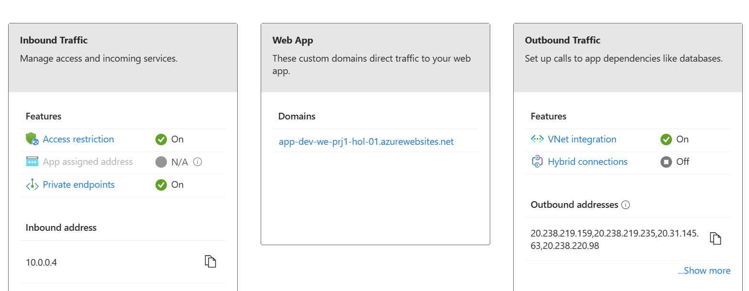
Create an App Service
If you succeed you should in the Networking section of your App Service these features On:

